Slide 1


Machine Learning-Enhanced Graphics:
an overview
NEXT SLIDE

Slide 2




Machine Learning-enhanced graphics:
an overview
Luca Quartesan
ML Researcher @ Traverse Research
Master Game Technologies @ BUas
Programming instructor @ BUas
LQrtsn
luca-quartesan
luca@traverseresearch.nl
Notes:
welcome everyone today I am going to give you an overview on machine learning enhanced graphics
I'm luca, a ML researcher at traverse research, where I am studying the intersection between ML and CG
This talk is about how machine learning can push graphics even further, and I'll show you where the current research is going

Slide 3

Goal
01
Photorealistic graphics
02
High resolution
03
High refresh rate
04
Scalable to a variety of devices
Notes:
scalable: run seamlessly from desktop to mobile devices/vr

Slide 4
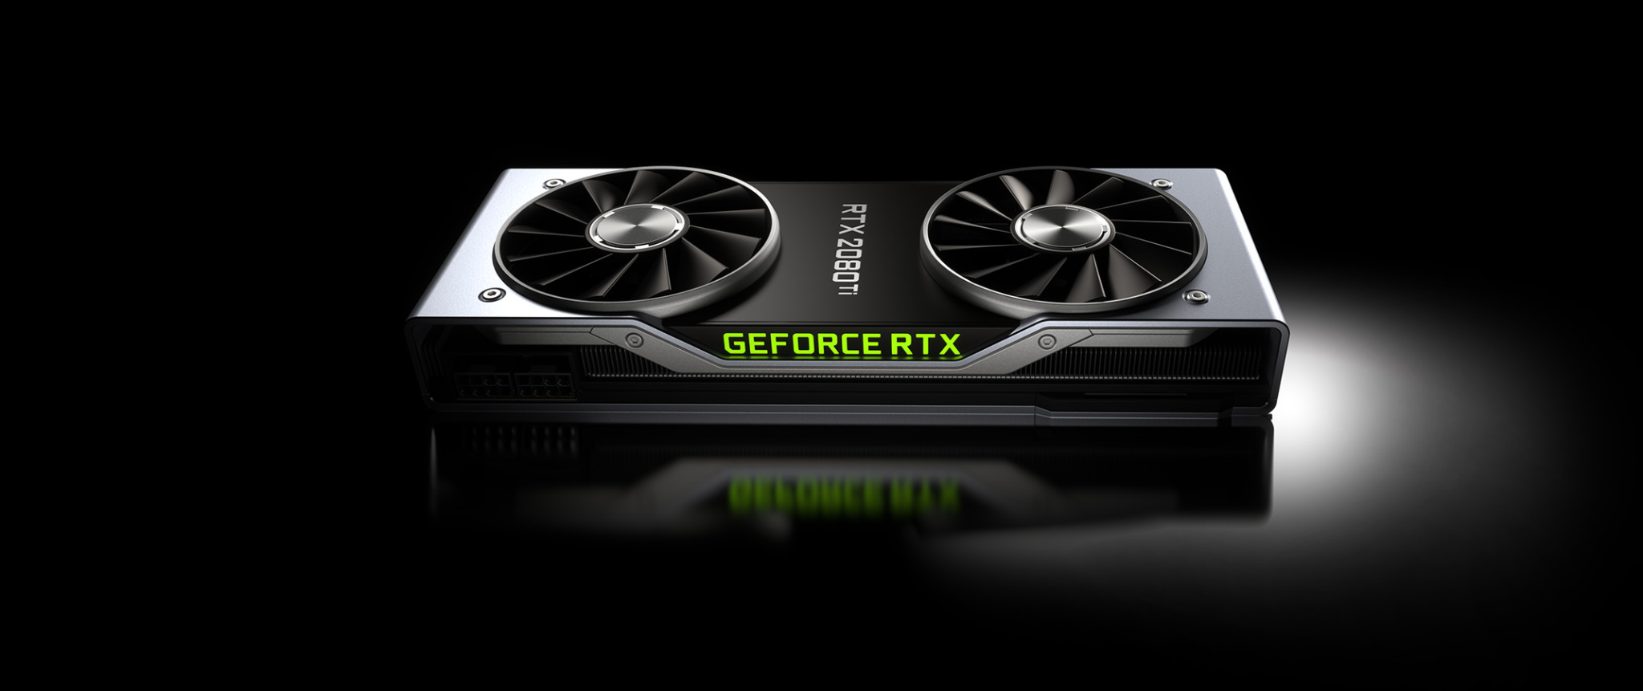


Hardware Solutions
01
Specialized hardware for graphics
Nvidia RT cores
02
Cloud solution
Nvidia CLOUD XR
03
Specialized hardware for Machine Learning
Nvidia Tensor Cores
Google Tensor
Notes:
There have been some advances on the hardware side:
Since the current hardware features specialized components for graphics and ML we want to leverage both

Slide 5
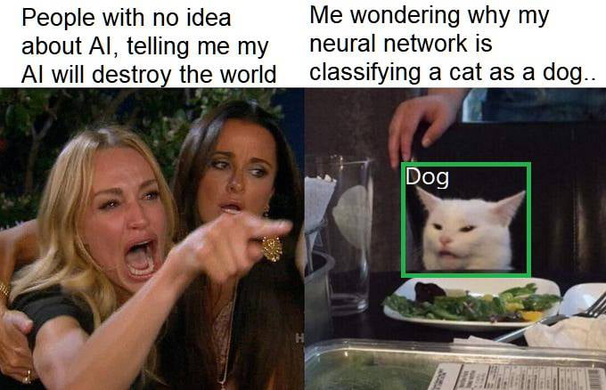
Neural Networks
01
Black box
02
Fixed size
03
Fixed compute
Input
Neural Network
Output
Notes:
I know, this talk is about ML, but most of the research I'm going to present, feature NN. ANN are a subset of ML which is inspired by how our neurons work. For this talk I'm not going to explain how NN work, I just want you to think about it as a black box that takes something in (an image), and outputs something (a class)
Fixed size and compute

Slide 6
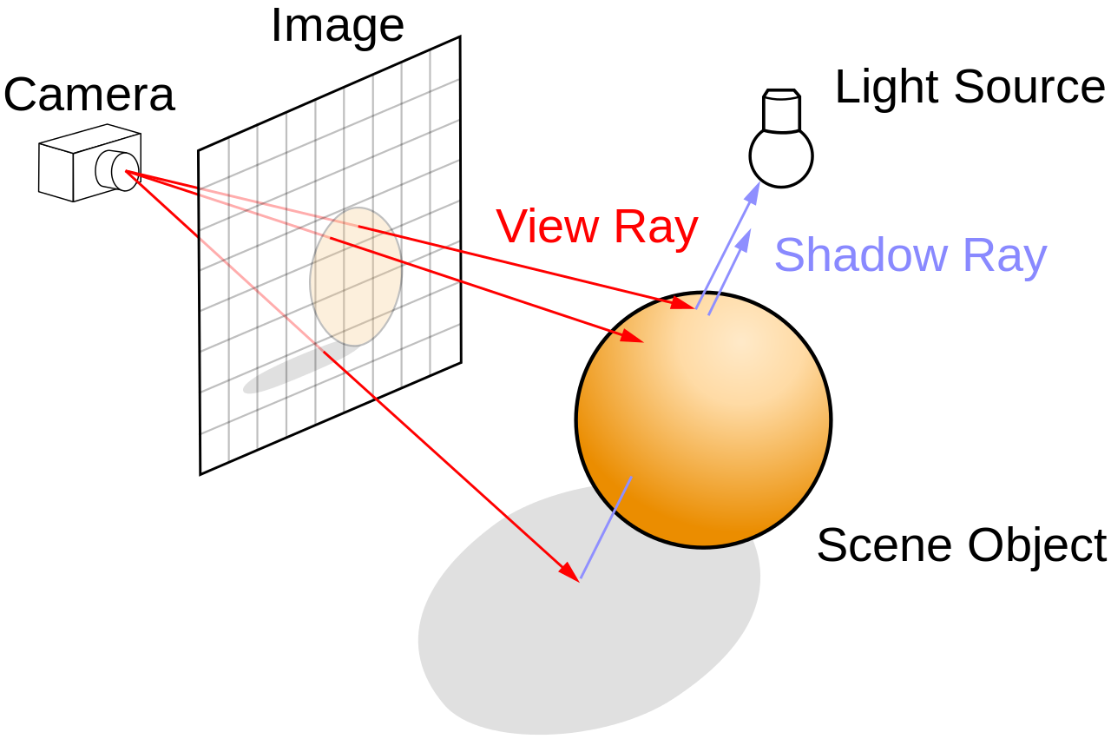
Rendering Pipeline
3D Scene
Geometry
Ray Tracing
https://en.wikipedia.org/wiki/Ray_tracing_(graphics)
Materials
Lights
Rendering Pipeline
Image
Camera
Notes:
in graphics we represent 3D scenes by using geometry, materials, lights and a camera that are passed to out rendering pipeline, that uses one of the many rendering algorithms to simulate how light will behave in our scene
Now let's see where we can insert ML in the rendering pipeline

Slide 7
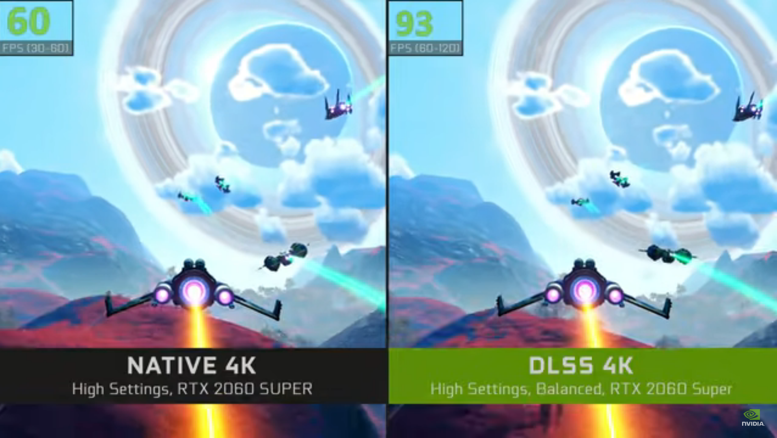
Super Sampling
01
Render at lower resolution = higher frame rate
02
Neural Network increases the resolution
3D Scene
NVidia DLSS 2.1
https://www.nvidia.com/en-us/geforce/news/may-2021-rtx-dlss-game-update/
Geometry
Materials
Lights
Rendering Pipeline
Image
(1080p)
Super Sampling
Image
(4k)
Camera
Notes:
the goal is to upsample: increase the resolution of our output which allows to offload some of the work of the renderer to a NN.

Slide 8
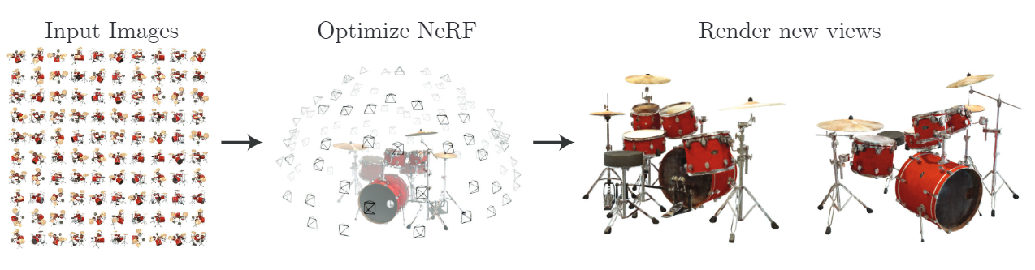
3D Scene
Geometry
Materials
neural Scene
Lights
Rendering Pipeline
Image
01
inverse graphics: 3D scene from an image
Camera
02
Novel view synthesis: given multiple images create a 3D scene
03
NeRF
Mildenhall, B., (2020).
NeRF: Representing scenes as neural radiance fields for view synthesis.
Notes:
We can use a NN to represent a scene. the field of inverse graphics: 3d scene from 2d image

Slide 9
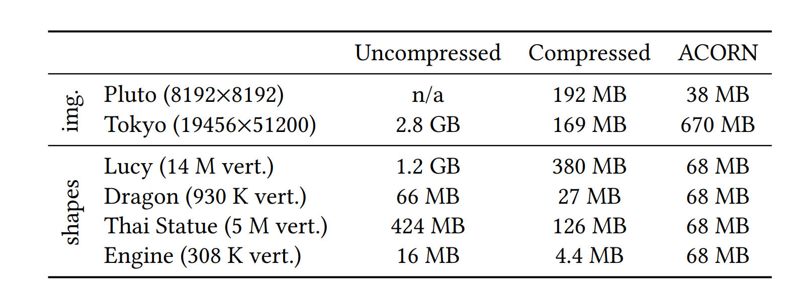
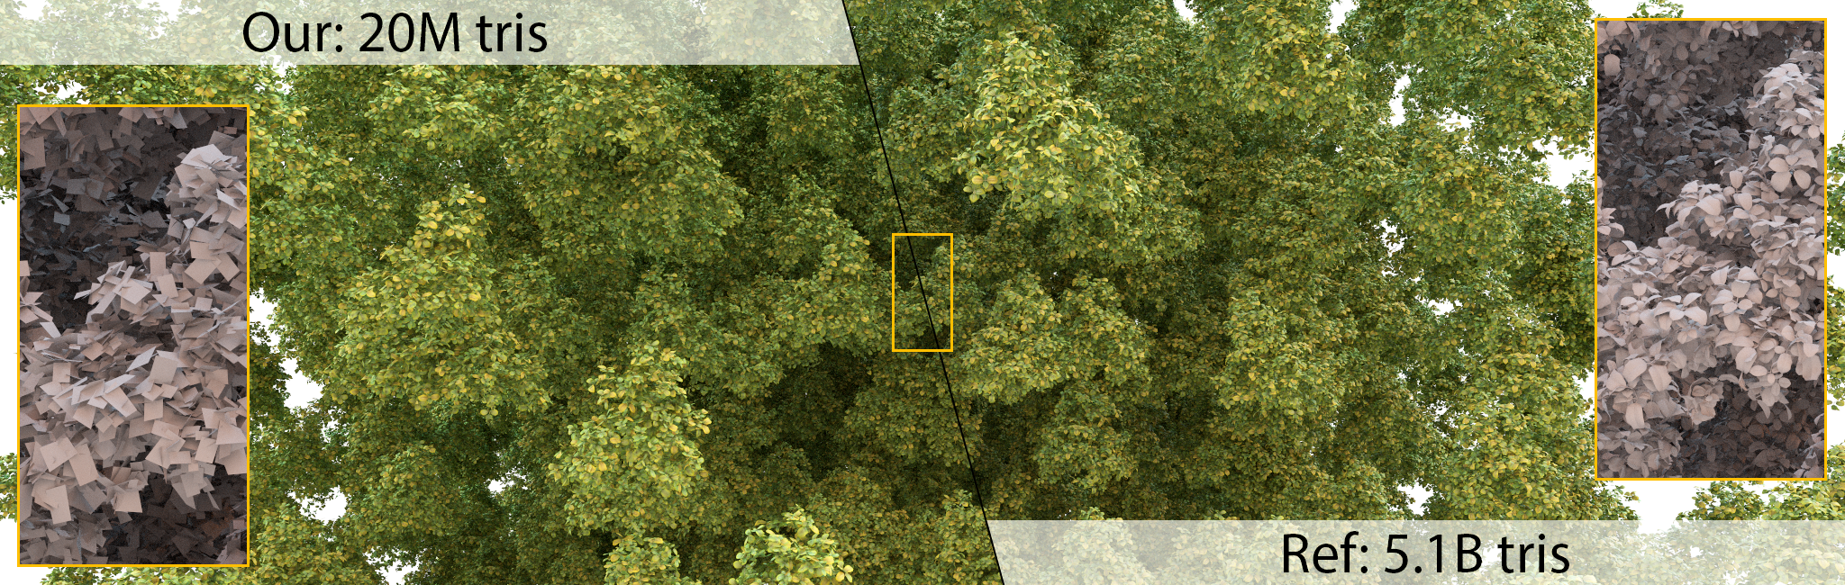
3D Scene
Geometry
Materials
Neural Geometry
Lights
Rendering Pipeline
Image
01
ACORN:
compress signal with neural network
Camera
02
autoLOD
reduces the amount of triangles
Martel, J. N. P., (2021).
ACORN: Adaptive Coordinate Networks for Neural Scene Representation.
Hasselgren, J., (2021).
Appearance-driven automatic 3D model simplification.
Notes:
We can compress data with NN. for example we can compress images or 3D models using NN. With acorn we train a NN to represent a 3d model
we usually represent 3D models with a collection of polygons usually triangles, with autoLOD: we try to optimize the amount of triangles used to by our 3D model by trying to match the high quality reference

Slide 10
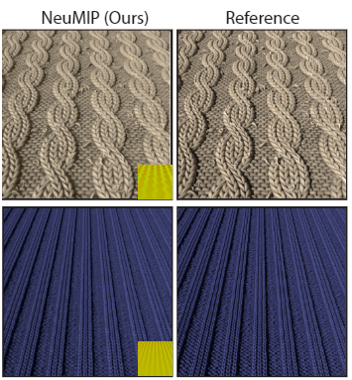
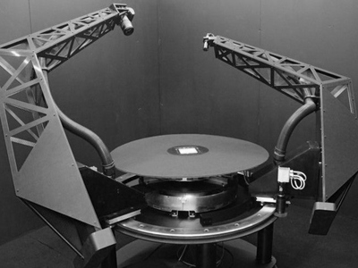
3D Scene
Geometry
Materials
Neural Materials
Lights
Rendering Pipeline
Image
01
BTF: real-life captures
Camera
02
Neumip: Neural network material
Rainer, G, (2019).
High-Resolution BTF Capture for Delicate Materials.
Kuznetsov, A. (2021).
NeuMIP.
Notes:
Can use NN to represent materials.
an example of this is when we want to use high resolution BTF captures, which consists in a collection of images of a material from different light and view angles. This is collected wiuth a gonioreflectometer, in the pic, where 2 arms, one with a camera and one with a light rotate around the object and create a collection of images
This is quite unfeasible since it is very expensive because it is a lot of images, but we can use a NN to encompass this information in a much smaller size, comparable to what we would normally use for materials

Slide 11

Production Rendering
Vogels, T., (2018).
Denoising with kernel prediction and asymmetric loss functions.
Notes:
used for movies. the goal is to achieve the higher quality and image possible. To do this we usually use more realistic rendering algorithms that bettter simulate light transport like path tracing. This systems accumulate more and more information through time and can take up to days to render a short sequence.

Slide 12
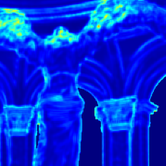
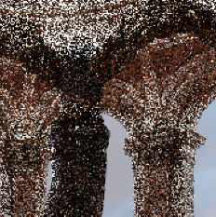
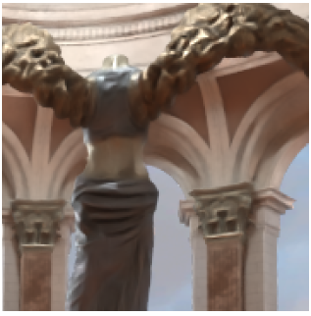
Production Rendering
01
Denoising
Sample map estimator
02
Importance sampling
3D Scene
Geometry
Materials
Lights
Rendering Pipeline
Denoiser
Camera
Hasselgren, J., (2020).
Neural temporal adaptive sampling and denoising.
Notes:
ML here is used to reduce the amount of samples necessary to achieve a clean image. tow examples of how this is achieved denoising and importance sampling

Slide 13
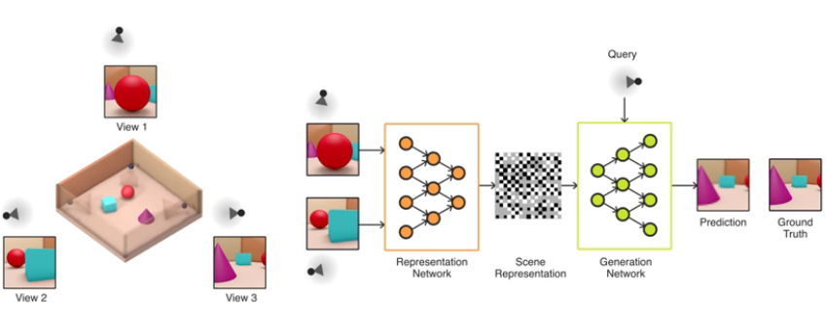
3D Scene
Geometry
Materials
Neural Rendering
Lights
Rendering Pipeline
Image
01
Rendering pipeline replaced by neural network
Camera
02
Generative Query Networks
from few observations
Eslami, S. M. A., (2018).
Neural scene representation and rendering.
Notes:
we can replace the entire rendering pipeline with a neural network. In

Slide 14
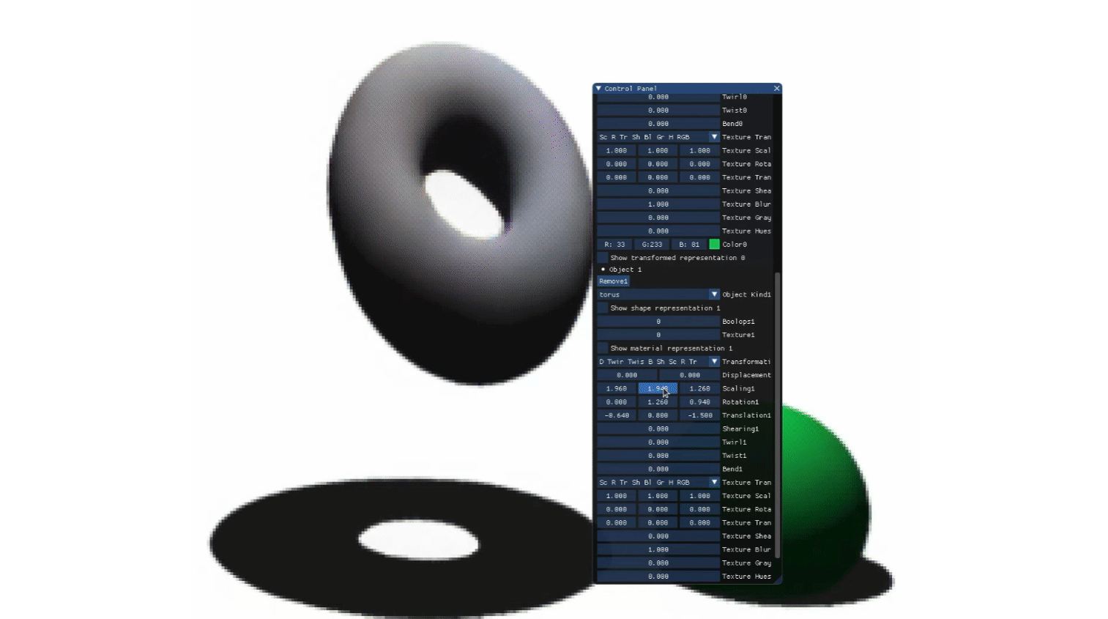
Granskog, J., (2021).
Neural scene graph rendering.
Neural Rendering
03.
Neural scene graph rendering
‹#› | PAGE

Slide 15
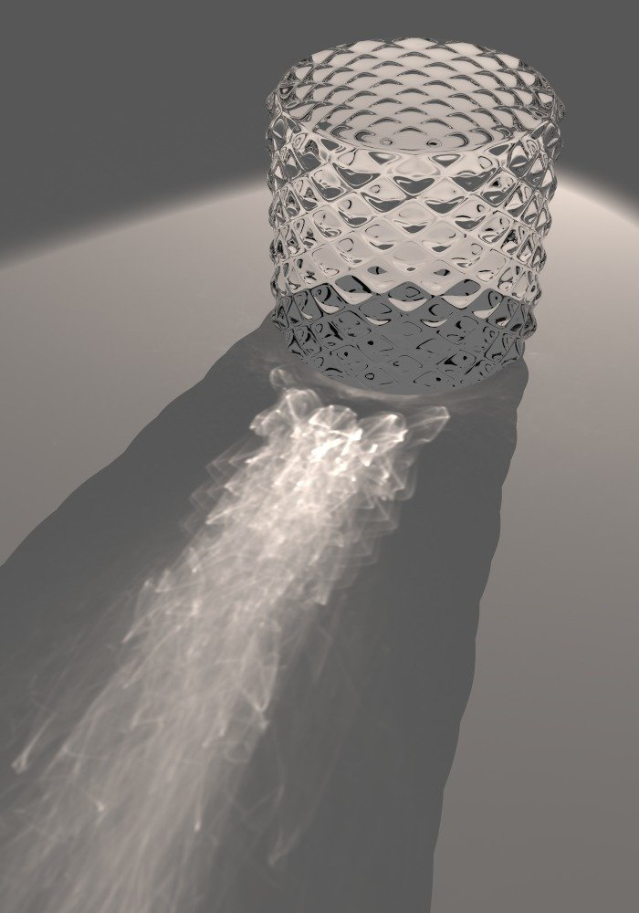
https://www.pbrt.org/scenes-v3_images/f16-9c.jpg
REcap
01
With Supersampling, we can render at lower resolution and achieve higher refresh rate
02
With Inverse Graphics we can create a 3D representation from few images/video
03
A Neural Network can represent 3D scenes
04
Speed up Production rendering by optimizing the amount of samples
05
Or simply replace everything with Neural networks
‹#› | PAGE

Slide 16

THANK YOU
luca@traverseresearch.nl

